Slide 1
Applied Data Science L9. k nearest neighbours
Irina Mohorianu
Head of Bioinformatics/ Scientific Computing @CSCI

Slide 2
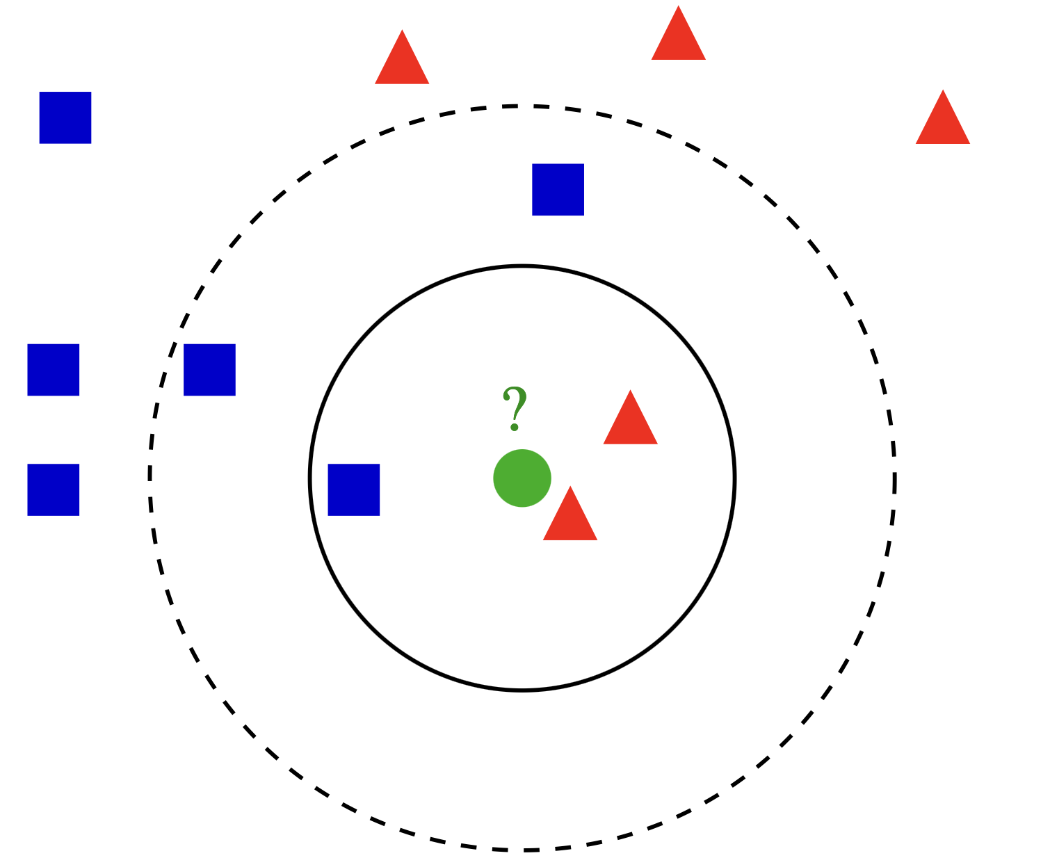
K nearest neighbours. Definitions
k-NN is by far the simplest method of supervised learning we will cover in this course.
It is a non-parametric/ semi-parameteric method that can be used for both classification (predicting class membership) and regression (estimating continuous variables).
k-NN is categorized as instance based (memory based) learning, i.e. all computation is deferred until classification.
The most computationally demanding aspects of k-NN are finding neighbours and storing the entire learning set.

Slide 3
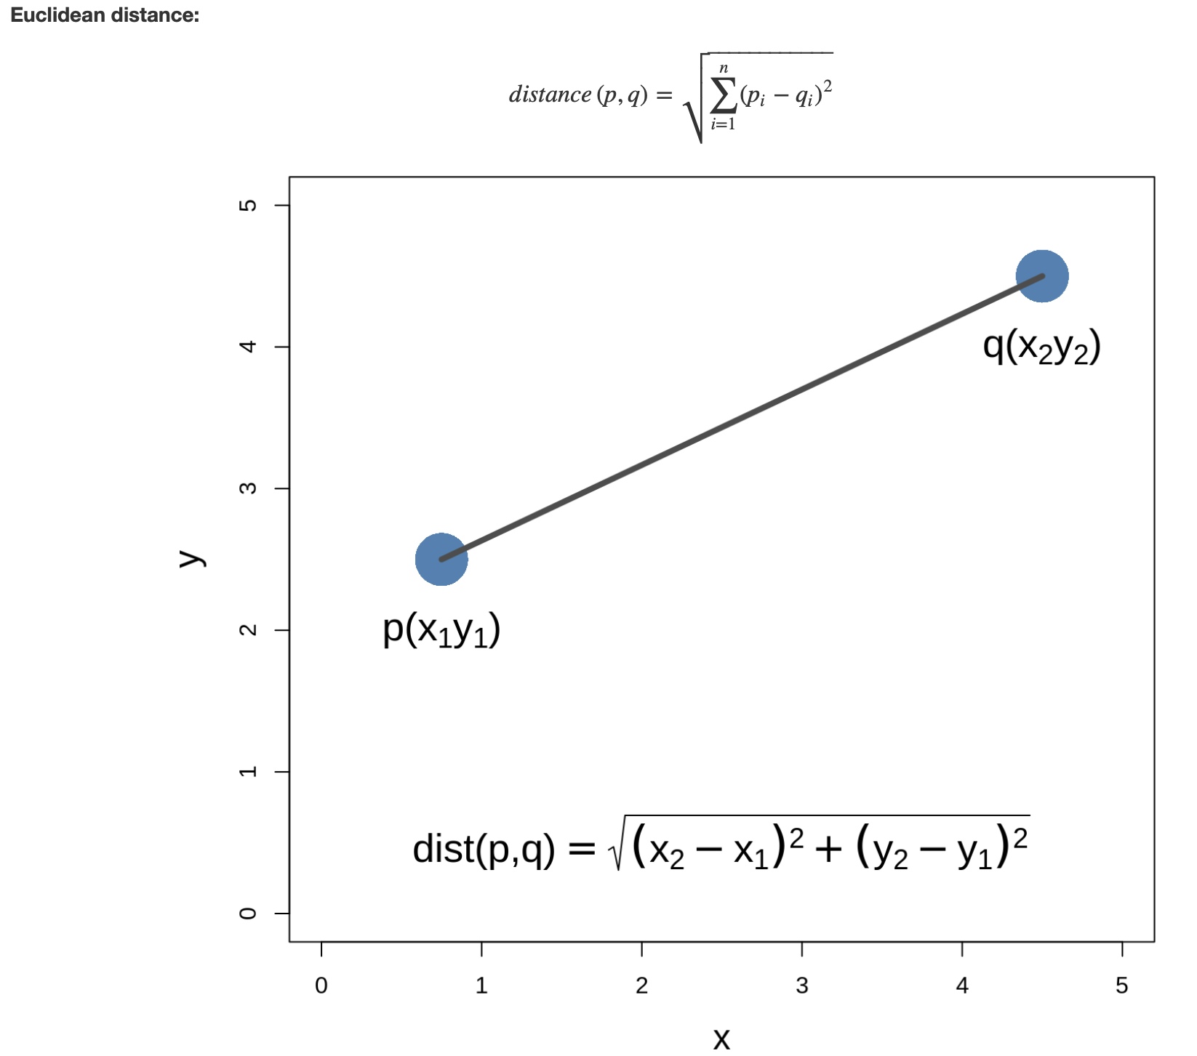
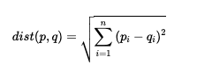
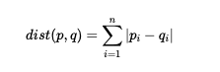
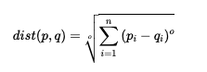
K nearest neighbours. Definitions
Euclidean Distance
Manhattan distance
Minkowski distance

Slide 4
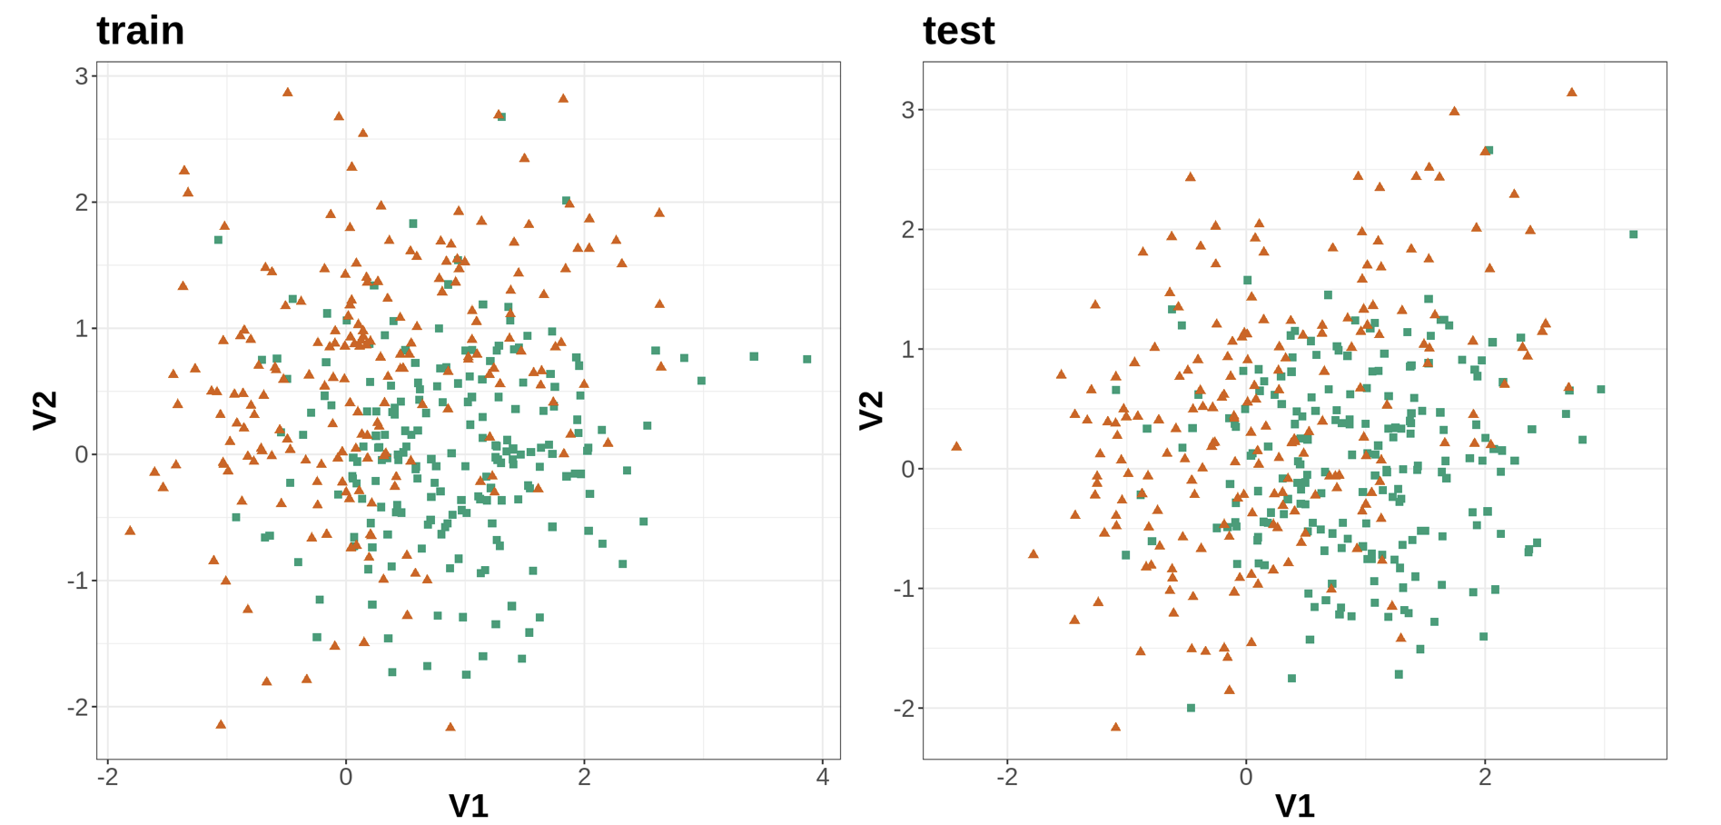
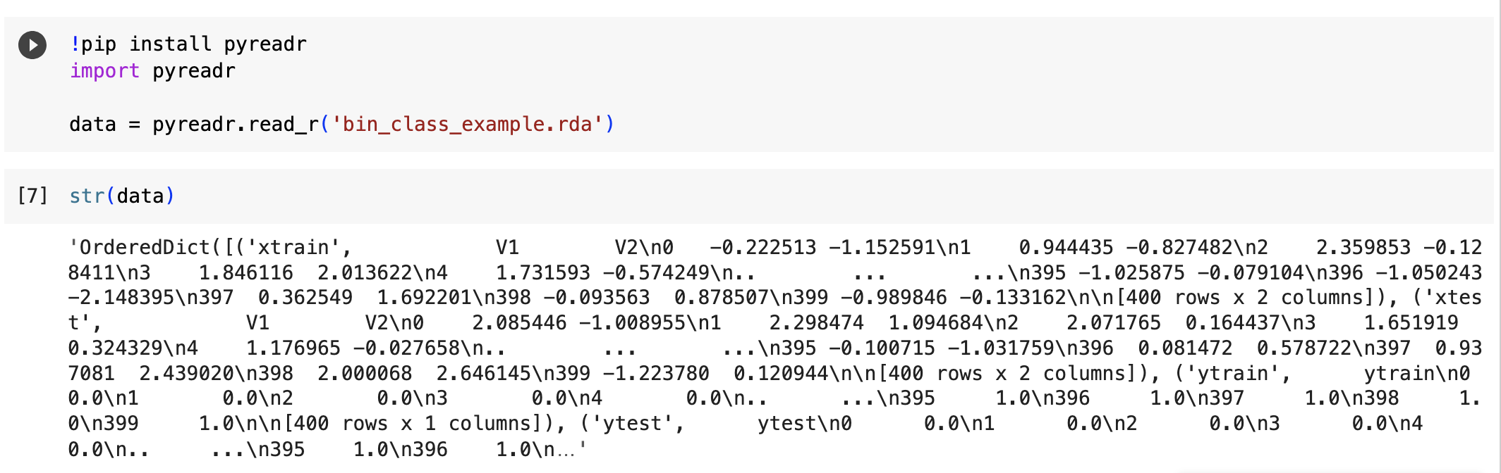
K nearest neighbours. Algorithm and parameters
A simulated data set will be used to demonstrate:
bias-variance trade-off
the knn function in Python
plotting decision boundaries
choosing the optimum value of k
We illustrate one split into train/ test

Slide 5
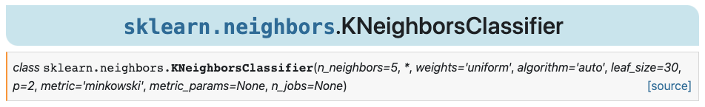
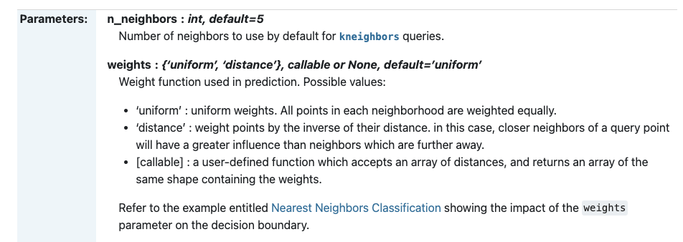
K nearest neighbours. Algorithm and parameters
https://scikit-learn.org/stable/modules/generated/sklearn.neighbors.KNeighborsClassifier.html

Slide 6
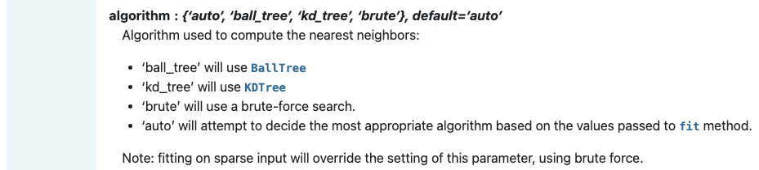
K nearest neighbours. Algorithm and parameters

Slide 7
K nearest neighbours. Algorithm and parameters
The ball tree nearest-neighbour algorithm examines nodes in depth-first order, starting at the root.
During the search, the algorithm maintains a max-first priority queue (often implemented with a heap, [Q]), of the k nearest points encountered so far. At each node B, it may perform one of three operations, before finally returning an updated version of the priority queue:
[1] If the distance from the test point t to the current node B is greater than the furthest point in Q, ignore B and return Q.
[2] If B is a leaf node, scan through every point enumerated in B and
update the nearest-neighbour queue appropriately. Return the updated queue.
[3] If B is an internal node, call the algorithm recursively on B's two children,
searching the child whose center is closer to t first.
Return the queue after each of these calls has updated it in turn.
Performing the recursive search in the order described in point 3 above increases likelihood that the further child will be pruned entirely during the search.
https://en.wikipedia.org/wiki/Ball_tree

Slide 8
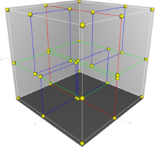
K nearest neighbours. Algorithm and parameters
a k-d tree (short for k-dimensional tree) is a space-partitioning data structure for organizing points in a k-dimensional space.
The k-d tree is a binary tree in which every node is a k-dimensional point.
Every non-leaf node corresponds to a splitting hyperplane that divides the space into two parts, known as half-spaces.
Points to the left of this hyperplane are represented by the left subtree of that node and points to the right of the hyperplane are represented by the right subtree.
https://en.wikipedia.org/wiki/K-d_tree

Slide 9
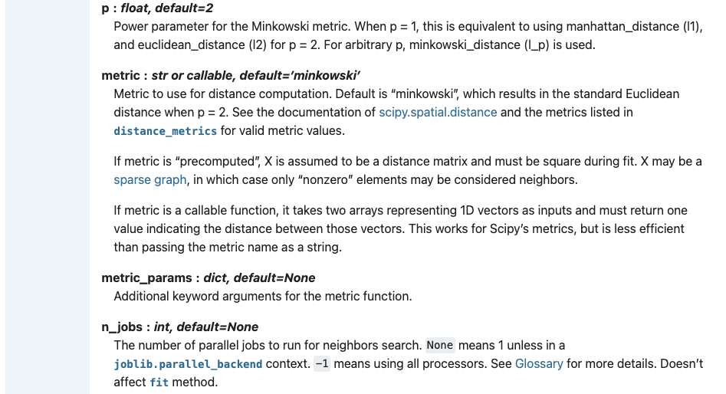
K nearest neighbours. Algorithm and parameters

Slide 10
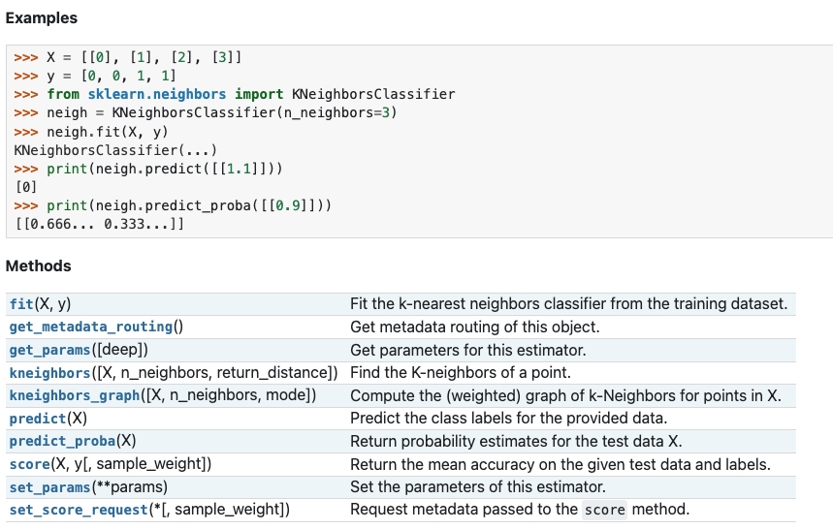
K nearest neighbours. Algorithm and parameters

Slide 11
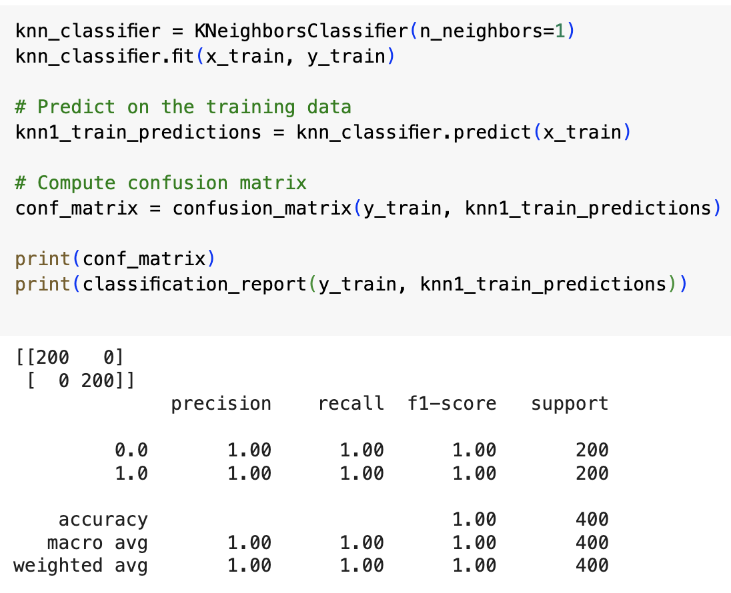
K nearest neighbours. Example 1

Slide 12
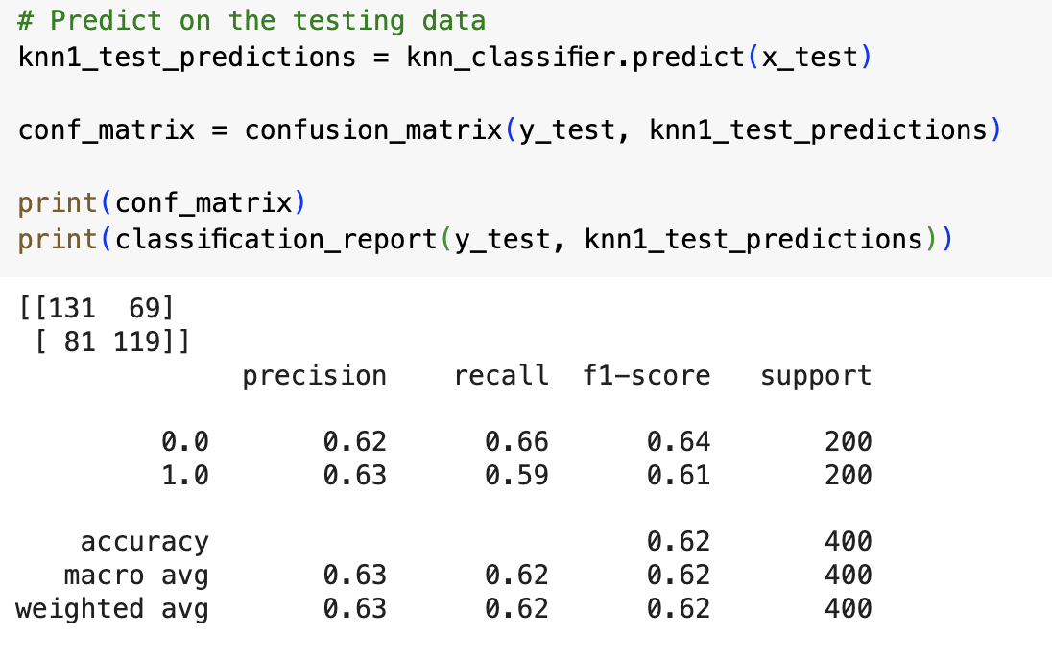
K nearest neighbours. Example 1

Slide 13
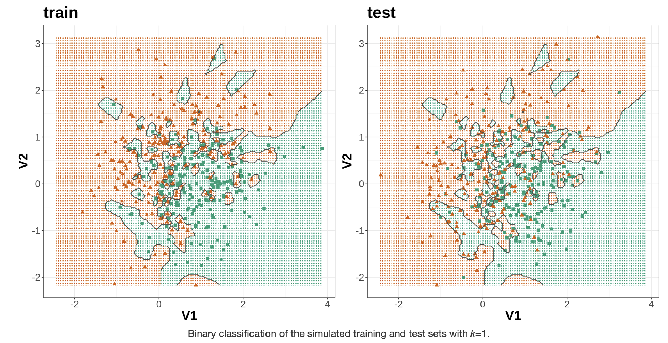
K nearest neighbours. Example 1
The model overfits on the training data and fails to generalise on the test data

Slide 14
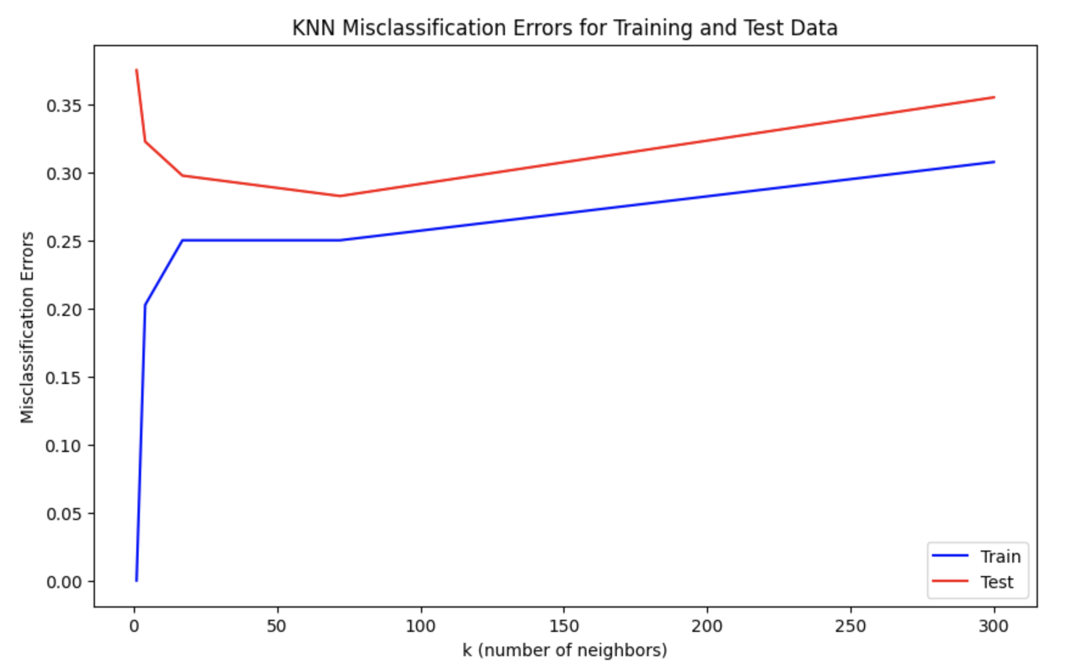
K nearest neighbours. Bias/variance trade-off
The bias–variance tradeoff is the problem of simultaneously minimizing two sources of error that prevent supervised learning algorithms from generalizing beyond their training set
The bias is error from erroneous assumptions in the learning algorithm. High bias can cause an algorithm to miss the relevant relations between features and target outputs (underfitting).
The variance is error from sensitivity to small fluctuations in the training set. High variance can cause an algorithm to model the random noise in the training data, rather than the intended outputs (overfitting).
To demonstrate this phenomenon, let us look at the performance of the k-nn classifier over a range of values of k.
underfitting
Plateau – keep it simple
overfitting

Slide 15
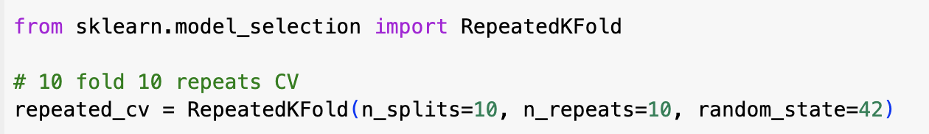
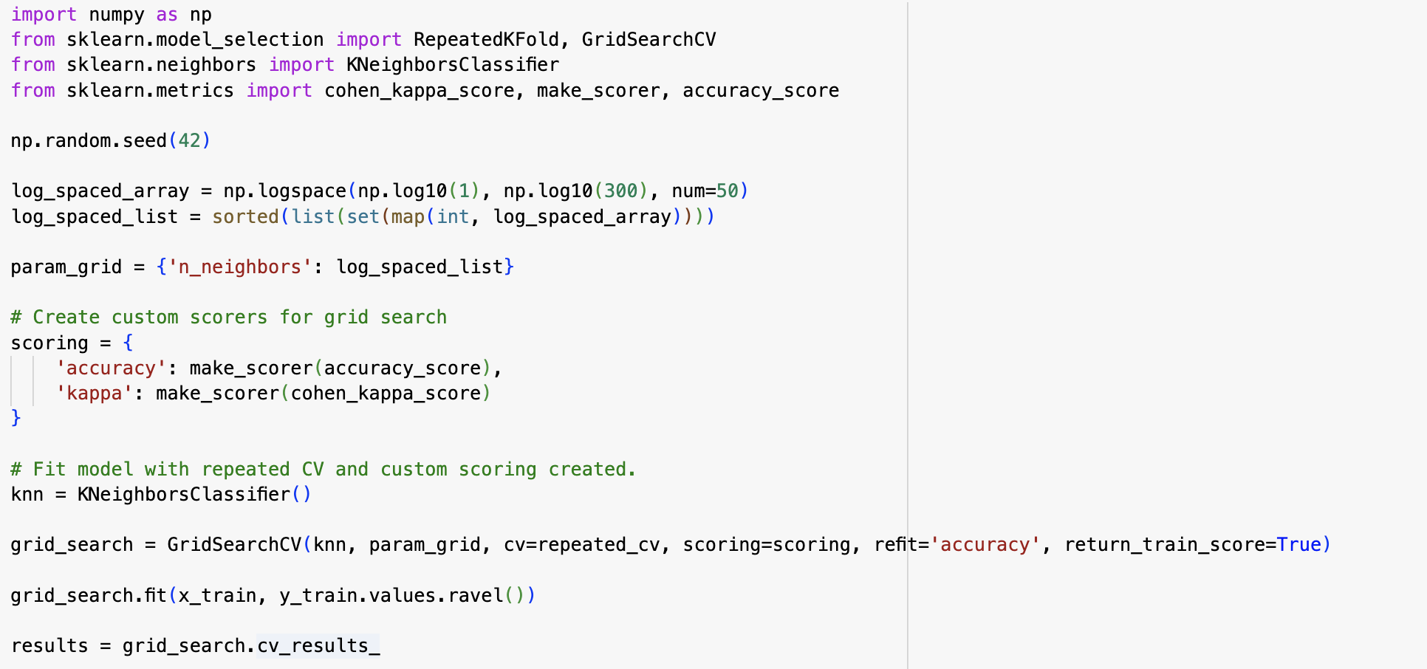
K nearest neighbours. Bias/variance trade-off

Slide 16
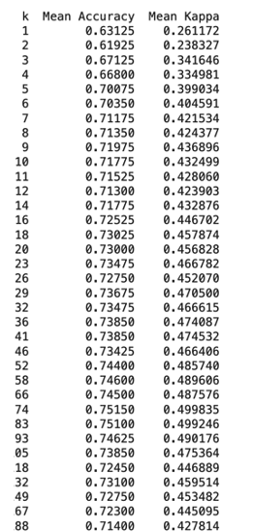
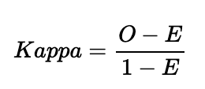
K nearest neighbours. Bias/variance trade-off
Cohen’s Kappa
Cohen’s Kappa:
O: observed accuracy, E: expected accuracy based on marginal totals of the confusion matrix.
Values between -1 .. 1;
0 corresponds to a random assignment

Slide 17
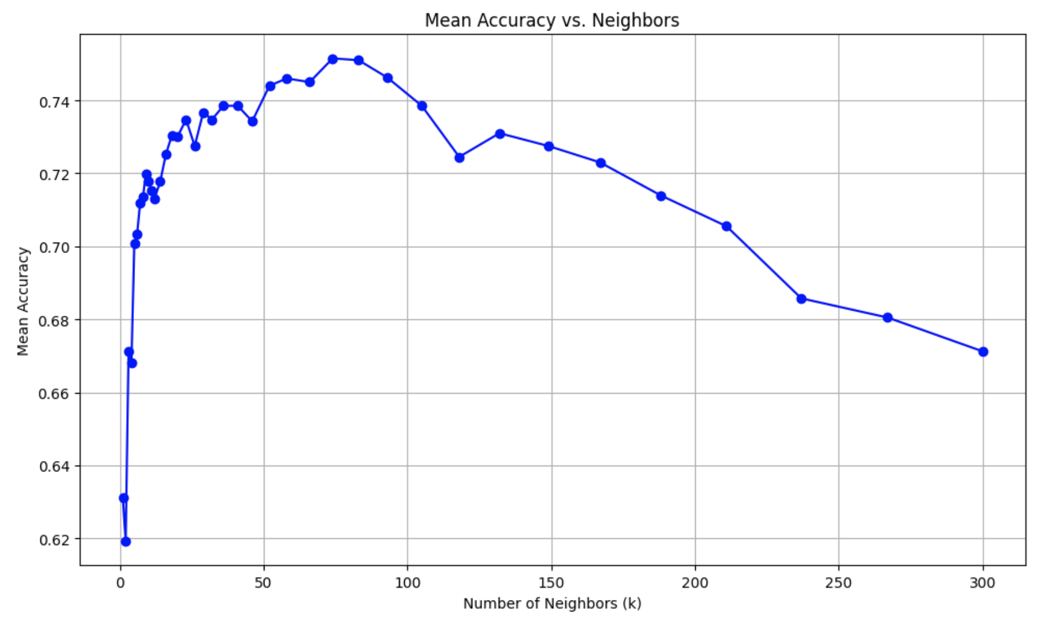
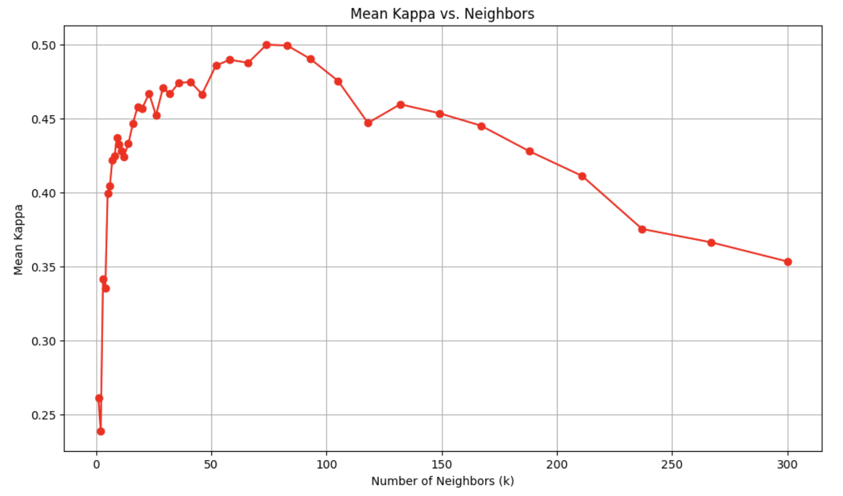
K nearest neighbours. Bias/variance trade-off

Slide 18
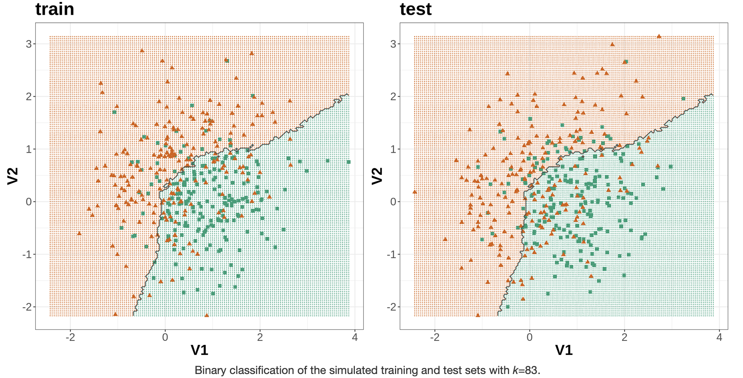
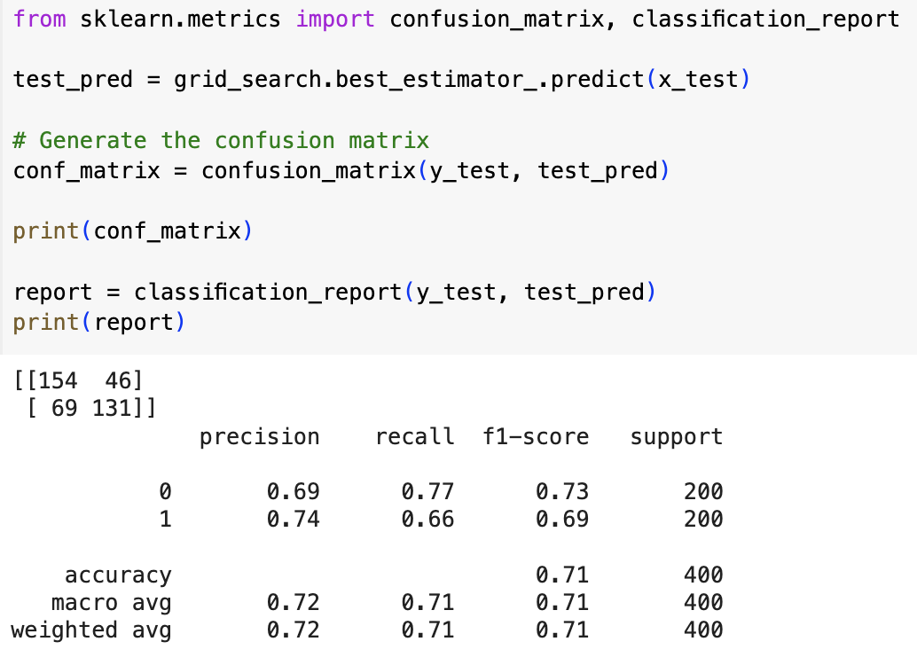
K nearest neighbours. Bias/variance trade-off

Slide 19
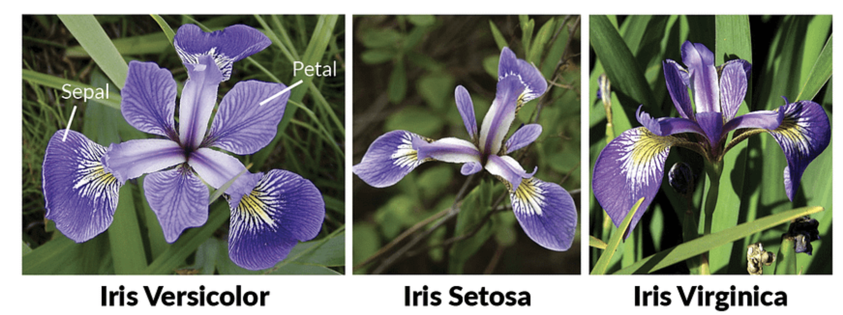
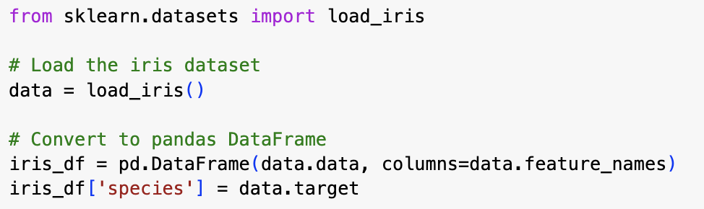
kNN on the iris dataset

Slide 20
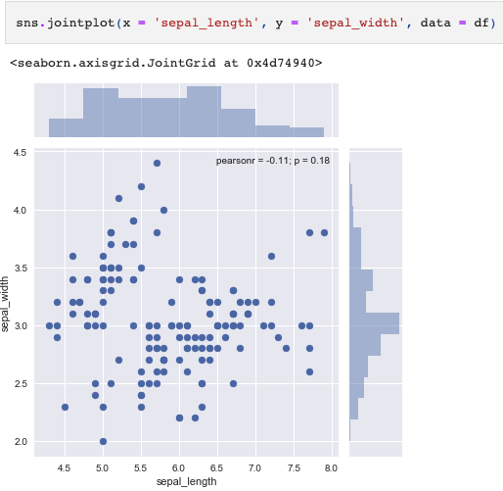
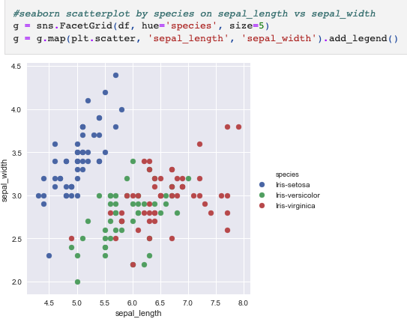
kNN on the iris dataset

Slide 21
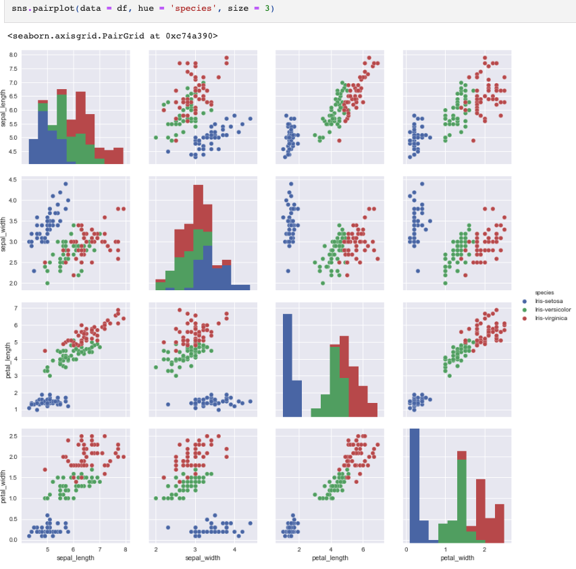
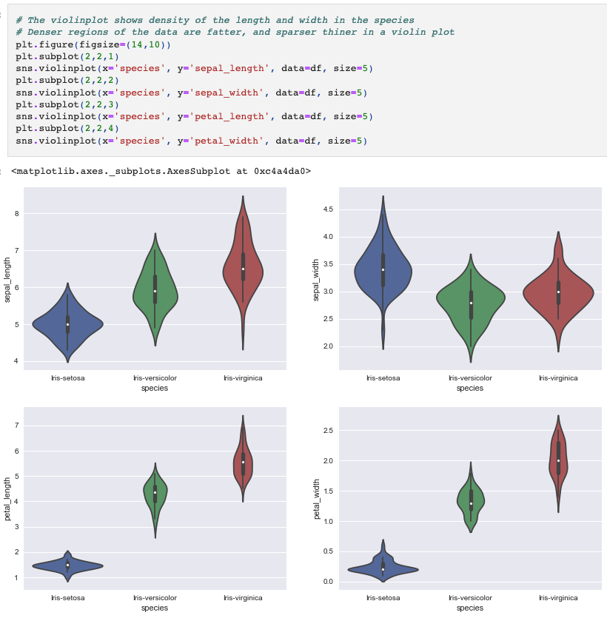
kNN on the iris dataset

Slide 22
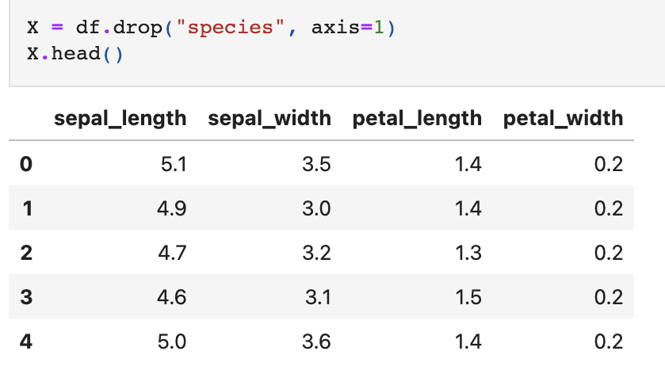
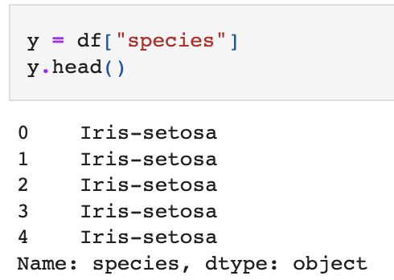
kNN on the iris dataset

Slide 23
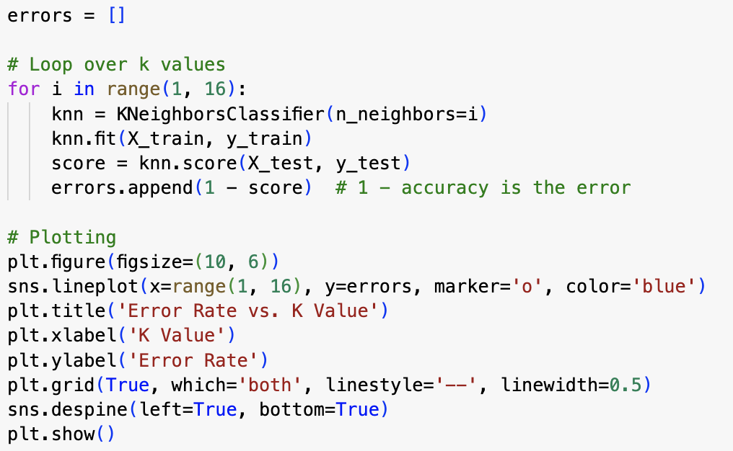
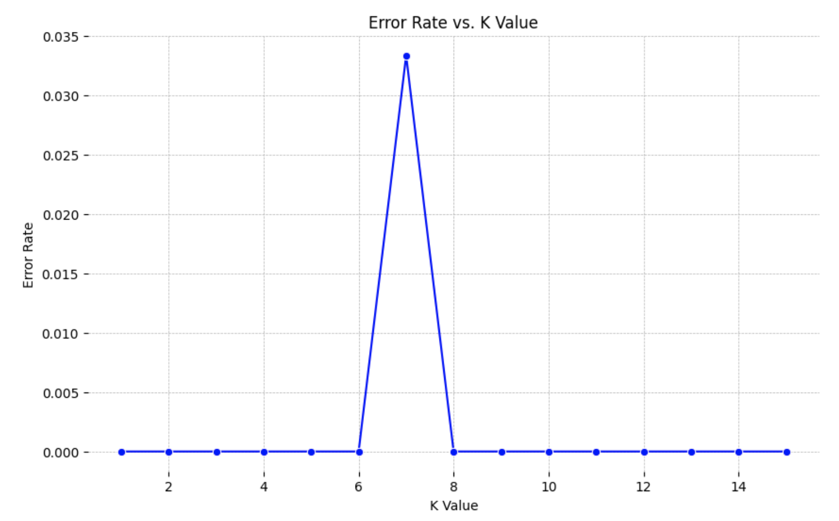
kNN on the iris dataset

Slide 24
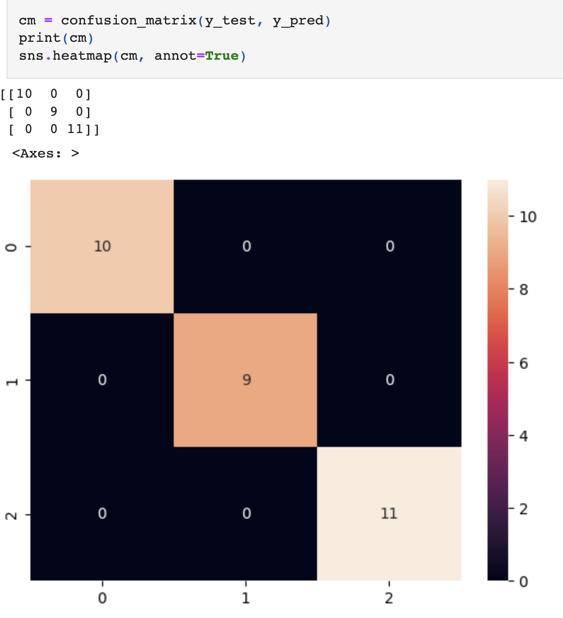
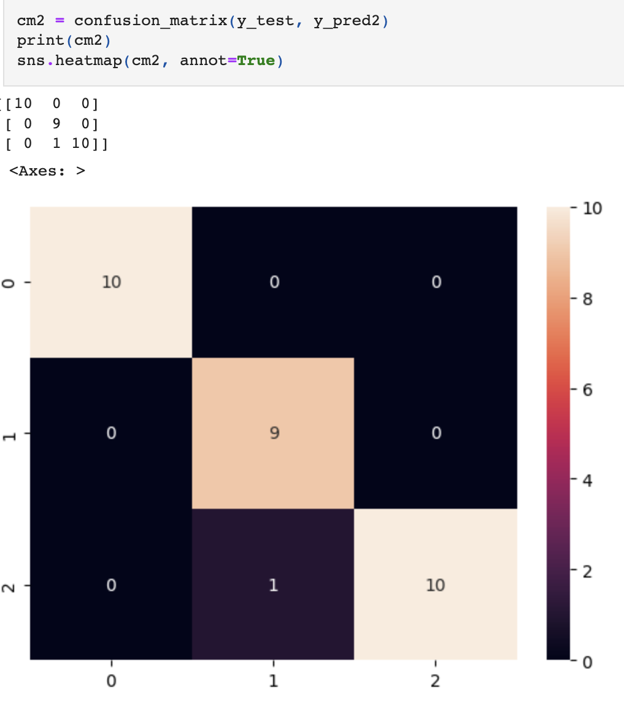
kNN on the iris dataset

Slide 25
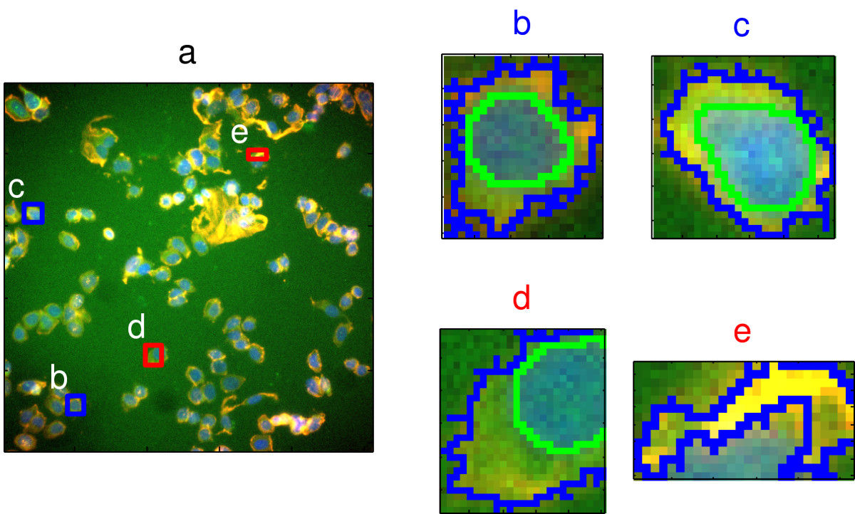
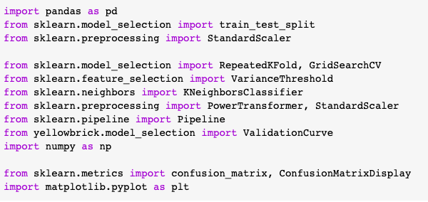
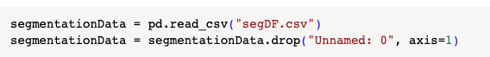
More kNN examples. Cell Segmentation example [classification]
Image segmentation in high content screening. Images b and c are examples of well-segmented cells; d and e show poor-segmentation.
Source: Hill et al (2007)
https://doi.org/10.1186/1471-2105-8-340

Slide 26
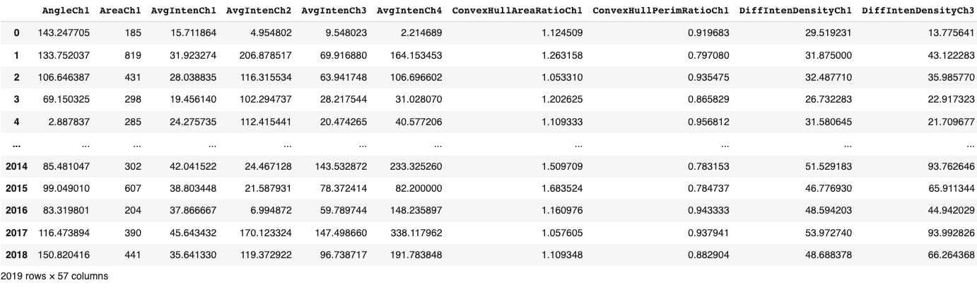
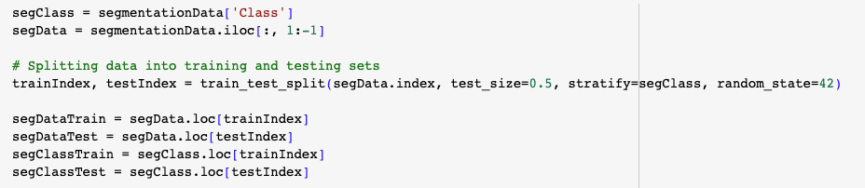
More kNN examples. Cell Segmentation example [classification]

Slide 27
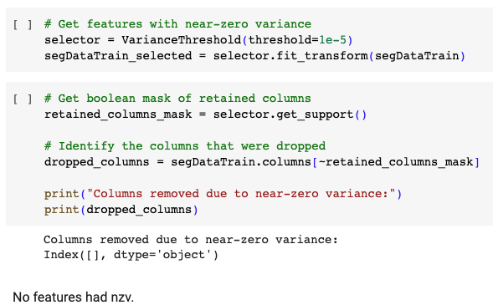
More kNN examples. Cell Segmentation example [classification] Near Zero variance

Slide 28
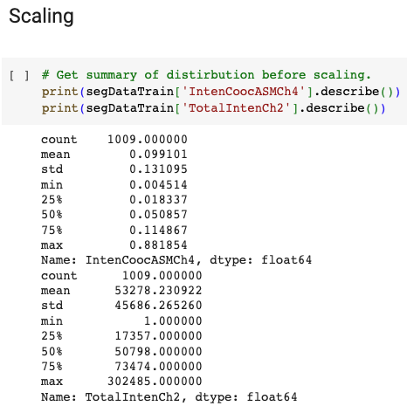
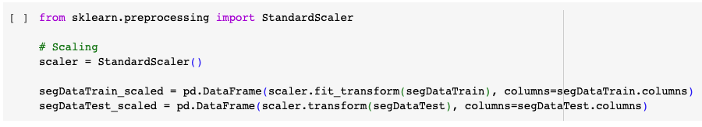
More kNN examples. Cell Segmentation example [classification]

Slide 29
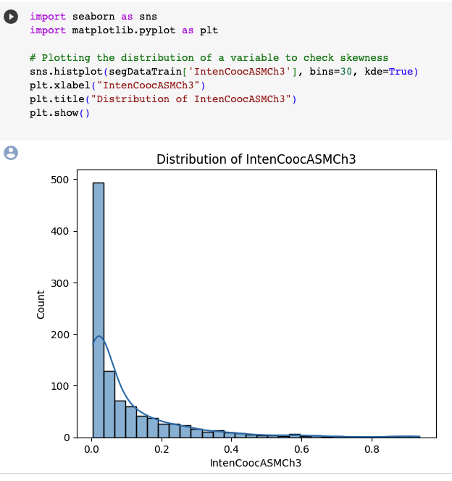
Cell Segmentation example [classification] Skewness

Slide 30
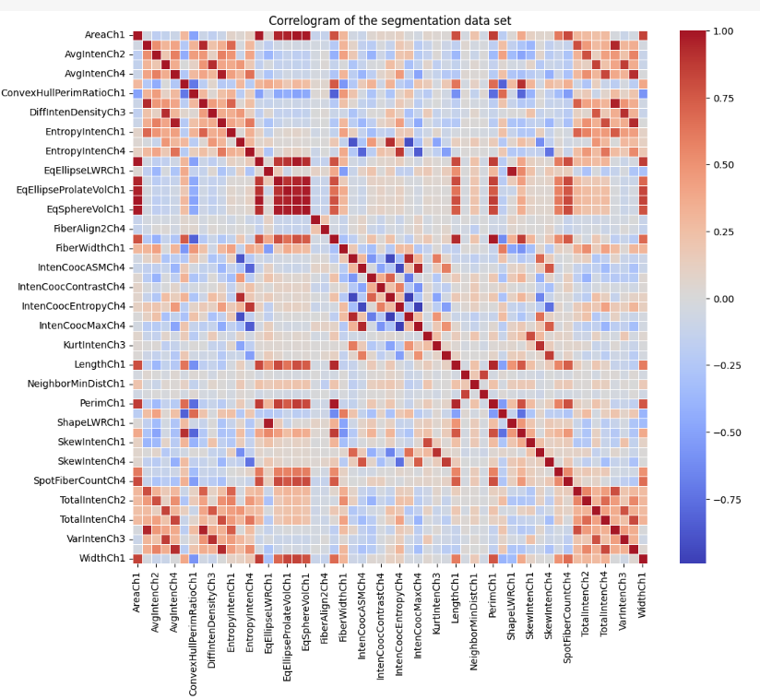
Cell Segmentation example [classification] Collinearity [assessment of correlations]

Slide 31
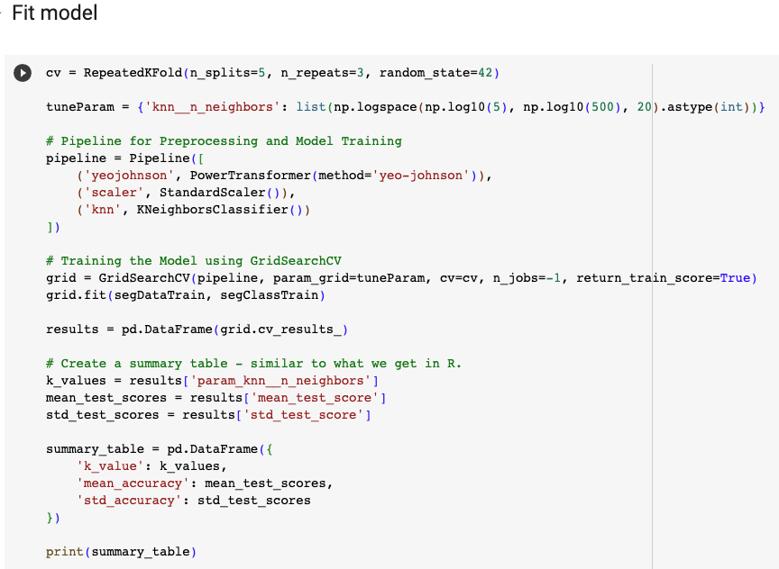
More kNN examples. Cell Segmentation example [classification]

Slide 32
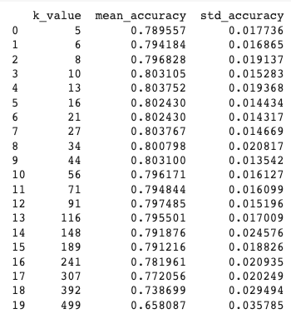
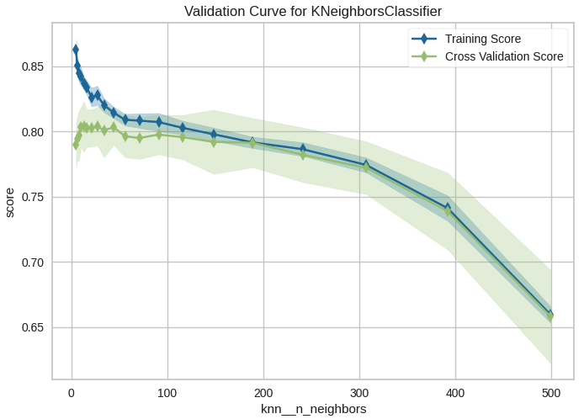
More kNN examples. Cell Segmentation example [classification]
TRAINING SET

Slide 33

More kNN examples. Cell Segmentation example [classification]

Slide 34


More kNN examples. Blood/brain barrier example [regression]

Slide 35



More kNN examples. Blood/brain barrier example [regression]

Slide 36

More kNN examples. Blood/brain barrier example [regression]

Slide 37

More kNN examples. Blood/brain barrier example [regression]

Slide 38

More kNN examples. Blood/brain barrier example [regression]

Slide 39

More kNN examples. Blood/brain barrier example [regression]

Slide 40

More kNN examples. Blood/brain barrier example [regression]

